Slide 1
What did we learn from National Core Indicators® about the demographics and outcomes of LTSS users in 2021-22?
Sarah Taub
Memorial Webinar
Human Services Research Institute
Dorothy Hiersteiner (dhiersteiner@hsri.org)
Stephanie Giordano (sgiordano@hsri.org)
NASDDDS
Laura Vegas (LVegas@nasddds.org)
ADvancing States
Rosa Plasencia (rplasencia@advancingstates.org)

Slide 2
Webinar logistics
All participants are muted. You can use the Q&A to communicate with hosts, or post questions in the Q&A.
We are recording this webinar and will share the recording and slides after the webinar.
This webinar will be live captioned in English and live interpreted in Spanish.
Live English captions can be accessed by clicking the “CC” button at the bottom of your zoom screen.
Live Spanish interpretation can be accessed by clicking the “interpretation” button at the bottom of your Zoom screen (world icon). Once in the Spanish channel, please silence the original audio.
Se puede acceder a la interpretación en español en vivo haciendo clic en el botón "interpretation" en la parte inferior de la pantalla de Zoom (icono del mundo). Una vez en el canal español, por favor silencie el audio original.

Slide 3
Agenda
Welcome and tribute to Sarah Taub
Introduction to National Core Indicators
Characteristics of NCI samples
2021-2022 In Review:
Person-centered planning
Community Participation and Employment
Healthcare
HCBS Settings Rule
Staffing
Implications and future directions

Slide 4
Sarah Taub
Sarah Taub was the National Core Indicators Director until 2013 when her life what cut short by an aggressive cancer.
Her sense of mission and purpose was an essential part of the growth of NCI to the prominence it has today.
She was a fierce advocate for people with disabilities, and for their representation at all levels in the work we do. She never let us forget the people behind the numbers.

Slide 5
Presenters
Val Bradley Stephanie Giordano Dorothy Hiersteiner Rosa Plasencia Laura Vegas
Special thanks to Lindsay DuBois, the driving force behind this webinar and to Saska Rajcevic for assisting with logistics.

Slide 6
National Core Indicators®
Helping states examine the outcomes of human service systems since 1997

Slide 7
National Core Indicators
Established
1997 NCI-IDD
2015 NCI-AD
Participating states
48 NCI-IDD
23 NCI-AD
Population addressed
People with IDD
Older adults
People with physical disabilities
Workforce
Covers multiple domains
Hears directly from people receiving services
State of the Workforce Survey

Slide 8
Goals of NCI
Establish a nationally recognized set of performance and outcome indicators for aging & disability (including IDD) service systems
Use valid and reliable data collection methods & statistical techniques to capture information directly for people who use services
Report individual state results and national benchmarks of indicators of system-level performance

Slide 9
NCI-IDD In-Person Survey (IPS) & NCI-AD Adult Consumer Survey (ACS)
Sampling: States design their samples with guidance from HSRI. Final samples must reach threshold of 95% confidence level and 5% margin of error based on sample frame.
Inclusion criteria:
IDD: Person receiving at least one service in addition to case management
AD: Person receiving one “active service” at least twice a week
Consent: Surveyors follow state specific consent requirements
Those who are surveyed are informed that their services will not be impacted directly by their responses
Surveyor training: All surveyors complete standardized training. IPS uses peer-surveyors as well.
Survey features:
May be conducted in-person or remotely
Includes detailed Background Information section that primarily comes from existing records
Surveys are available in multiple languages
Questions may be rephrased or reworded
Allows for use of proxy for select questions

Slide 10
NCI-IDD Family Surveys
Mail out surveys designed to understand the experience of families of people receiving DD system services
Information is answered by the family or guardian of the person receiving at least one service in addition to case management
Three surveys:
Adult Family Survey (AFS) – sent to families who live with the person with IDD
Family Guardian Survey (FGS) – sent to families who do not live with the person with IDD
Child Family Survey (CFS) – sent to families who live with a child wit IDD

Slide 11
NCI Reporting
Data collected through NCI are reported annually through national and state reports
National reports show state outcomes compared to national norms
IPS report also breaks out data by residence setting
ACS report also breaks out data by program
NCI also produces supplemental reports to dig deeper into specific topic areas

Slide 12
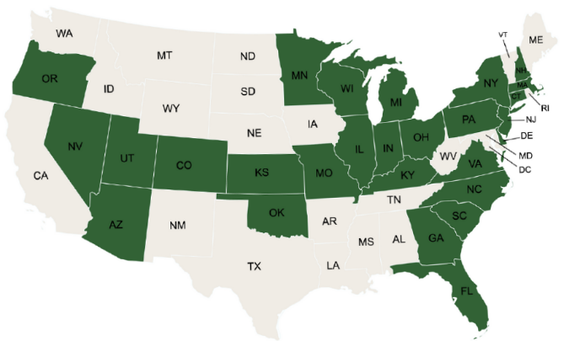
NCI-IDD IPS Sample
25 states represented
13,559 total respondents
42 Average Age
60% Male
87% Have IDD Diagnosis

Slide 13
NCI-IDD Family Survey Samples
Adult Family Survey
12 states
11,989 respondents
Family member with IDD:
35 average age
59% male
66% have ID diagnosis
Family/Guardian Survey
10 states
8,050 respondents
Family member with IDD:
45 average age
60% male
74% have ID diagnosis
Child Family Survey
8 states represented
7,902 respondents
Child member with IDD:
11 average age
71% male
34% have ID diagnosis

Slide 14
Has ASD diagnosis by IDD Survey
*IPS data are from person’s records; AFS, FGS, and CFS are self-reported by the respondent about their family member receiving series

Slide 15
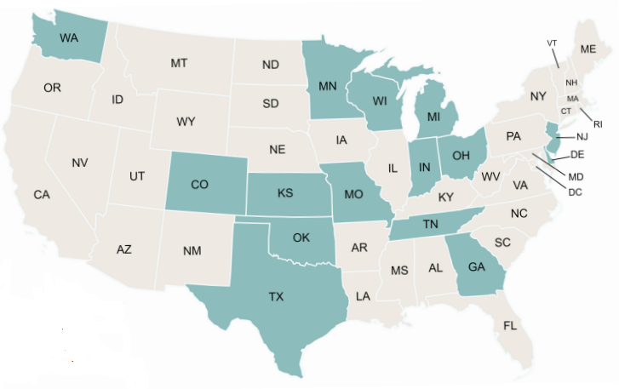
NCI-AD ACS Sample
15 states represented
13,663 total respondents
67 Average Age
32% Male
69% 60 and older
70% Have physical disability

Slide 16
The majority of NCI-IDD IPS and NCI-AD ACS respondents are White. At about one-fifth of respondents, the next highest proportion are Black.
White 71% IPS
60% ACS
Black
16% IPS
23% ACS
Hispanic or Latino
5% IPS
9% ACS
American Indian or Alaskan Native
1% IPS
2% ACS
Other
2% IPS
2% ACS
Asian
2% IPS
5% ACS

Slide 17
Respondents to the AFS and CFS reported greater diversity among their family members with DD compared to FGS

Slide 18
Most respondents lived in an urban or suburban area*
 | IDD IPS | AD ACS | AFS | FGS | CFS
Urban or Suburban | 91% | 86% | 78% | 87% | 84%
Rural and small towns | 10% | 15% | 22% | 13% | 16%
*IPS and ACS data are from RUCA codes based on the person’s zip code; AFS, FGS, and CFS are self-reported by the respondent

Slide 19
Co-occurring mental health disorder by survey*
*IPS and ACS data are from person’s records; AFS, FGS, and CFS are self-reported by the respondent about their family member receiving series

Slide 20
The majority of respondents with IDD have a guardian
IPS
AFS
65%
FGS
71%
ACS
15%
52%

Slide 21
A higher rate of ACS respondents were using a self-direction option
19% IPS
33% ACS

Slide 22
58% of IPS respondents who used a self-direction option reported they make decisions or have input in making self-direction decisions

Slide 23
A Year in Review
What we learned from NCI in 2021-22

Slide 24
Person-Centered Planning

Slide 25
Nearly all respondents reported the service planning meeting included the people the person wanted to be there

Slide 26
Fewer ACS respondents reported the service plan includes things that are important to them

Slide 27
About 3 in 4 respondents to the IPS and ACS helped make their service plan. That means nearly 1 in 4 respondents to the IPS did not help make their plan.
25% IPS
21% ACS

Slide 28
...and even fewer family member with DD helped make their service plan according to Family Survey respondents
65% AFS
18% CFS
63% FGS

Slide 29
Community Participation and Employment

Slide 30
Around two-thirds of IPS and ACS respondents could do things in the community as much as they want to
69% IPS
62% ACS

Slide 31
About 9 out of every 10 people have transportation for work or medical appointments, but fewer have transportation for leisure.
Has a way to get places they need to go (like work, medical appointments)
IPS: 93%
ACS: 90%
Able to get places when they want to do something outside of the home for fun
IPS: 78%
ACS: 74%

Slide 32
Around 8 out of 10 people are able to see and/or communicate with their families when they want
IPS: 83%
ACS: 85%

Slide 33
The rate of community employment among IPS respondents dropped slightly since COVID, while the rate of people wanting to work increased
Has a paid community job
19% 2018
16% 2021
Wants a paid job
44% 2018
49% 2021

Slide 34
Employment among ACS respondents remained at 3% since COVID, interest in working dropped two and a half times
Has a job
3% 2018
3% 2021
Wants a job
23% 2018
9% 2021
Increases to 17% for people under 60

Slide 35
One in five ACS respondents reported they often felt lonely. That’s twice as many as IPS respondents.

Slide 36
Healthcare

Slide 37
Has Medicare Coverage
IPS: 42%
ACS: 79%

Slide 38
IPS respondents were more likely than ACS respondents to have had a dental exam in the past year

Slide 39
1 out of 10 IPS respondents describe their health as poor, while almost 1 out of 5 ACS respondents describe their health as poor

Slide 40
A quarter of IPS respondents went to the ER to get care for themselves in the past twelve months. A higher rate of NCI-AD respondents went to the ER.

Slide 41
NCI-AD respondents under 60 were more likely to have access to mental health services, but less likely to feel in control of their life and more likely to often feel lonely*
*All significant at .01

Slide 42
Only half or fewer of Family Survey respondents reported their family member with DD can always get mental or behavioral health supports when needed
46% AFS
39% CFS
52% FGS

Slide 43
Measuring HCBS Settings Rule

Slide 44
A higher rate of IPS respondents reported that others ask before entering their home

Slide 45
Twice as many IPS respondents compared to ACS chose or could change their roommate
*IPS percent is out of those who do not live with family
*ACS percent is out of those who live in group residential settings

Slide 46
NCI-IDD Outcomes by Provider-Owned Settings
*All significant at .01

Slide 47
NCI-AD Outcomes Among People Living in Group Settings

Slide 48
Staffing

Slide 49
Nearly all IPS and ACS respondents reported staff are respectful of their culture
95% IPS
92% ACS

Slide 50
Fewer respondents to the NCI-IDD Family Surveys report staff are respectful of their family’s culture
80% AFS
77% FGS
80% CFS

Slide 51
A higher rate of NCI-AD ACS respondents could choose or change their staff if they wanted
79% ACS
63% IPS

Slide 52
NCI-IDD IPS respondents were more likely to report staff change too often
40% IPS
25% ACS

Slide 53
Family Survey respondents whose family member did not live in the family home were most likely to report staff change too often
33% AFS
43% FGS
37% CFS

Slide 54
Impact of Staff Turnover
Those who reported staff change too often tended to report lower outcomes in several areas. Some examples include:
Always having enough help with self-care and everyday activities
Satisfaction with staff
Community inclusion
Transportation

Slide 55
What are the takeaways and what do we do next?
Recapping themes across NCI Surveys

Slide 56
What’s going well and where is the room for improvement?
Staffing: High rates of feeling respected by staff, but turnover is related to poorer outcomes
Person-centered planning: High rates of service plans including what matters to people, but improvements needed to ensure person-centered process of developing plans
Community inclusion and employment: Impacts of COVID on lower community participation may be persisting, more supports for people who desire employment are needed
Healthcare: Access to some preventive health services, but access to mental health and dental is lacking for some populations and ER utilization is high
HCBS Settings Rule: Privacy, visitors, and rules show good progress towards compliance, but choosing roommates, locking doors show significant room for improvement in supporting choices

Slide 57
Implications and Future Directions
In some cases, we see stark differences across the populations that suggest further research is needed to understand what contributes to differences and how to ensure all populations have equitable and positive outcomes.
We encourage states to collaborate with partners to look at who is included in their samples and who they are not hearing from.

Slide 58
What Next?
State Administrators
Look at where your state is compared to the national norm and other similarly situated states
Have conversations with communities about their experiences and barriers to access
Have conversations with staff and people being served about their experiences
Advocates and Quality Councils
Policy makers
Look at national and state trends to identify how policies may be impacting outcomes
Providers
Use data to inform areas for improvements
Work with community members to develop innovative approaches to improve quality
Use reports to support conversations with states and policy makers about needed changes
Reach out to us with any additional suggestions for how we can look at data

Slide 59
Ways to get involved with NCI
Want to help us improve our surveys? Contact us about participating in a survey revisions workgroup
Want to help collect the data? Contact us about how to become a surveyor or find out whether your state uses peer surveyors
Have a burning research question or hypothesis you want to test? Contact us to learn about how to request access to de-identified data

Slide 60
Results At-A-Glance
NCI-AD reports, and AD SoTW Pilot Technical Report: https://nci-ad.org/reports/
NCI-IDD IPS and Family Survey reports, and IDD State of the Workforce: https://idd.nationalcoreindicators.org/survey-reports-insights/

Slide 61
Recent NCI presentations and publications
IDD Data briefs and highlights:
Person-centered practices and outcomes of people with I/DD
Paid Family Caregivers
College and university enrollment
AD Spotlights on Facebook and LinkedIn:
Older Americans and Mental Health
Americans with Disabilities Act
Subscribe to the NCI Updates newsletter and check out our website to stay up to date: nationalcoreindicators.org

Slide 62
More Info: Person-Centered Planning

