Slide 1

More Than Just Numbers:
Health Inequities for People with Disabilities

Slide 2





Agenda
Introduction to health disparities
Overview of National Core Indicators
What does the data tell us about health disparities for people with disabilities?
Implications and future directions
2
Notes:
Notes Page Title Here
(edit this in notes view)

Slide 3
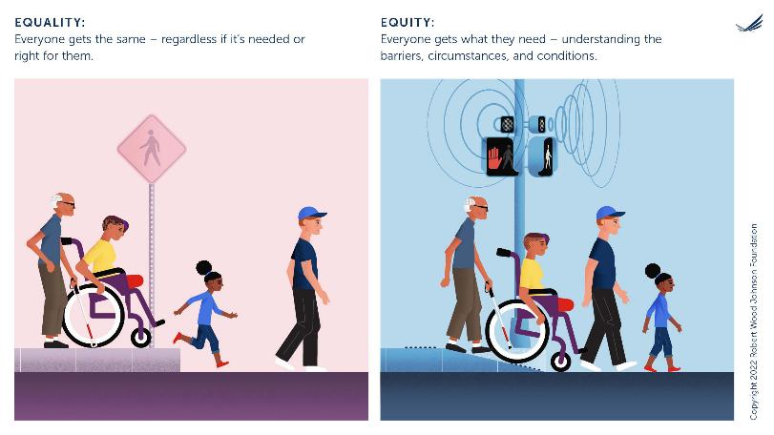
Equity – a picture is worth a thousand words

Slide 4
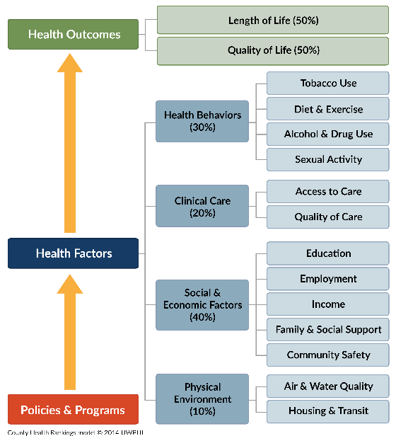
The many factors that influence health
This 2014 visual from the County Health Rankings and Roadmaps project shows how access to care and quality of care is one piece of the puzzle, but there are many others.

Slide 5

Research has consistently found that people with disabilities experience health disparities
Health disparities are avoidable differences in health between two groups
Disparities for people with disabilities exist across the world, and in the US
People with disabilities have higher rates of many chronic health conditions, as well as higher rates of mental health conditions
These chronic conditions impact quality of life and life expectancy

Slide 6
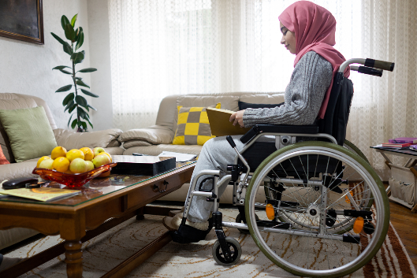
Contributors to health disparities
According to the WHO, health disparities “arise from unfair conditions faced by persons with disabilities, including stigma, discrimination, poverty, exclusion from education and employment, and barriers faced in the health system itself.”

Slide 7
A case study of Sarah: a woman with Down syndrome
25 years old
35 years old
45 years old
Newly diagnosed with diabetes
Sarah’s ability to manage diabetes is connected to:
  Her living situation
  Her support system
  Community resources
  Her medical history
Considering starting family with boyfriend
Sarah’s readiness to start a family is connected to:
  Her living situation
  Her support system
  Her employment
  Her knowledge about sexual and reproductive health
  Her medical history
Had a fall at her apartment
Sarah’s ability to be safe and live independently is connected to:
  Her living situation
  Her support system
  Her brain health
  Her medical history
Case study based on book chapter from van Heumen, DuBois, and Hussaini coming soon!

Slide 8
To close gaps in health outcomes, we have to be able to measure the gaps
Measuring these disparities isn’t as easy as it seems for many reasons…
Data quality issues
Can we identify people with disabilities in existing data?
Do we have the same data on people with disabilities as we do on those without?
How was the data collected? And who may have been included/excluded?
Did we gather data from proxies or people with disabilities directly?
Did we use methods to make sure that people with speech disabilities or who speak other languages can also be part of data collection?
Is the data from just one point in time or do we have data over time?

Slide 9

Current data that is used to study health of people with disabilities
Federal survey efforts
Federal administrative data
State data sources
Longitudinal studies and other data sources

Slide 10
Overview of survey data
In the US, we have a few surveys that are meant to capture information about the whole population. For example:
  The Census, including American Community Survey (annual) and Current Population Survey (monthly)
  The National Health Interview Survey
  Health and Retirement Study
  National Survey of Children’s Health
  Behavioral Risk Factor Surveillance System (BRFSS)

Slide 11
Overview of administrative data
Another term for administrative data is “program data.” This is data that gets collected when someone uses services. For example:
  Healthcare data, like data from Medicaid
  Education data, like data from Special Education
  Benefits data, like data about Social Security
  Data from cancer registries

Slide 12
Pros and cons of survey data and administrative data on IDD
Survey data
Administrative data
Pros: These data are good at telling us about most people in the population
Cons: It’s hard to use national surveys like these to learn about people with specific disabilities, like IDD.
Pros: We can usually tell who has disabilities, like IDD, from these data
Cons: We may only have data on some people who use services, so we can’t talk about whether data is different from peers

Slide 13

Lots of interest in improving data on disability and health, but it’s a long journey
To improve data, we need to:
  Include people with disabilities in surveys
  Use good definitions of disability in surveys and administrative data
  Look for ways to connect data from different programs to learn more about health and other outcomes
  To learn more about efforts to improve IDD data, check out the I/DD Counts project!
  Acl.gov/iddcounts

Slide 14
Current disability policy activities
OBBBA funding preserved support for DD Act programs, Independent Living programs, and Older Americans Act programs
OBBBA cuts federal spending on Medicaid and Medicare
States will have fewer resources and will be looking at tradeoffs to address budget shortages, such as:
  Decrease enrollment in Medicaid?
  Decrease spending on optional services like HCBS; decrease hours/service coverage?
  Decrease reimbursements for providers?

Slide 15

Right now, it’s more important than ever to measure and monitor health disparities for people with disabilities
This workshop will look at the ways in which we can use existing data to explore possible comparisons, as well as where we need further research to understand the extent of disparities.

Slide 16

About National Core Indicators®

Slide 17



National Core Indicators: People Driven Data
National Core Indicators interviews people with disabilities and older adults who get services from their state Intellectual and Developmental Disabilities or Aging and Disabled systems.
NCI surveys help us learn how people are doing. We share the information (de-identified) to people who oversee state systems. This helps them to understand where things are going well and where things can go better.

Slide 18
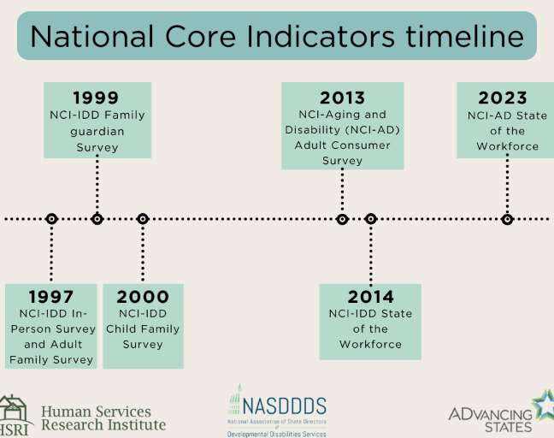
National Core Indicators
(NCI)
NCI tools collect data on performance and quality of life indicators directly from:
people who use disability and/or aging services systems;
families; and
those who deliver services
Participating states:
NCI-IDD IPS and Family Surveys: 48
NCI-AD: 26
State of the Workforce: 30 states for the NCI-IDD SoTW, and 6 states for NCI-AD SoTW
NOTE: All NCI data is available for secondary analysis!

Slide 19

Using NCI data for research: The exit ramp
NCI data can reveal patterns and trends, but it doesn’t necessarily tell you:
The root cause(s)
The right solution(s)
NCI data should be used to start a conversation about the things that may contribute to outcomes.
This helps to think about various solutions to improve systems.

Slide 20

NCI-IDD In-Person Survey (IPS) and NCI-AD Adult Consumer Survey (ACS)
Sampling: States design their samples to be representative of their service population
Inclusion criteria:
  AD: Person receiving one “active service” at least twice a week
  IDD: Person receiving at least one service in addition to case management
Consent: Those who are surveyed are informed that their services will not be impacted directly by their responses
Surveyor training: All surveyors complete standardized training. IPS uses peer-surveyors as well.
Survey features: Flexible administration modes/methods

Slide 21

NCI-IDD Family Surveys
Mail out surveys designed to understand the experience of families of people receiving DD system services
Information is answered by the family or guardian of the person receiving at least one service in addition to case management
Three surveys:
  Adult Family Survey (AFS) – sent to families who live with the person with IDD
  Family Guardian Survey (FGS) – sent to families who do not live with the person with IDD
  Child Family Survey (CFS) – sent to families who live with a child with IDD

Slide 22
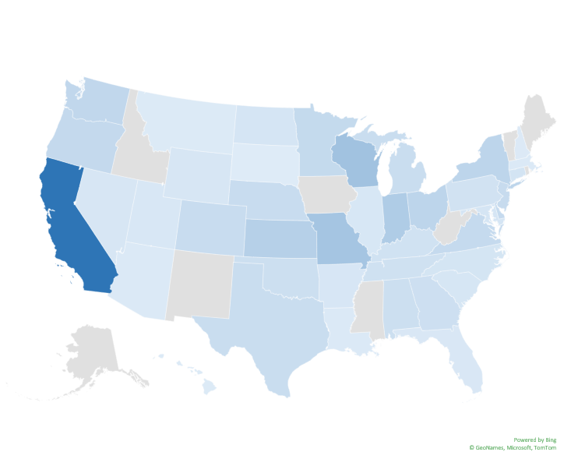
Sample from NCI-AD ACS, NCI-IDD IPS, and NCI-IDD CFS from 2022-2024
Across the three surveys, we heard from 92,424 people with disabilities and family members in 42 states
AD ACS: 36,496
IDD IPS: 43,009
IDD CFS: 12,919

Slide 23

NCI-AD ACS sample characteristics
43% are <65 years old
Race/Ethnicity
  61% White
  25% Black
  7% Hispanic
  4% Asian
  3% American Indian/Alaska Native
  2% Other
74% live in their own or family home
NCI-AD data include people receiving services from their state aging & disability system

Slide 24

NCI-IDD IPS sample characteristics
43% between 18-34 years old
Race/Ethnicity
  65% White
  18% Black
  13% Hispanic
  4% Asian
  2% American Indian/Alaska Native
  2% Other
43% live in parent or a relative's home
NCI-IDD data include people receiving services from their state development disability system

Slide 25

NCI-IDD CFS sample characteristics
Race/Ethnicity
  49% White
  39% Hispanic
  13% Asian
  9% Black
  3% American Indian/Alaska Native
  3% Other
39% respond they or another family member are paid to provide supports
NCI-IDD data include people receiving services from their state development disability system

Slide 26
Conditions among NCI-AD respondents <65
Disability make-up:
75% have a physical disability
9% have a chronic psychiatric condition and no other physical/cognitive disabilities
*data come from administrative sources and self-report

Slide 27
Conditions among NCI-IDD IPS respondents
Disability make-up:
17% have no ID (they are getting services for DD)
42% have at least one mental illness (anxiety, mood, or psychotic disorder)
*all data described here come from administrative data sources

Slide 28
Conditions among NCI-IDD CFS respondents
Disability make-up:
39% have ID
71% have ASD
16% have at least one mental illness (anxiety, mood, or psychotic disorder)
*all data described here are reported by family members

Slide 29
Population health datasets
Behavioral Risk Factor Surveillance System (BRFSS)
National Survey of Children’s Health (NSCH)
Annual telephone survey of people in all 50 states and DC
Available in Spanish
Excludes those who live in nursing homes and long-term care facilities
Self-reported data, no proxies allowed
Disability measure is the ACS 6 functional limitation questions
Annual mail and web-based survey of children in all 50 states and DC
Available in Spanish
Excludes children who live in institutional settings
Several disability measures, including “emotional, developmental, or behavioral problems”

Slide 30
BRFSS Disability Definition
Disability Status is determined using six questions:
1. “Are you deaf or do you have serious difficulty hearing?” (hearing)
2. “Are you blind or do you have serious difficulty seeing, even when wearing glasses?” (vision)
3. “Because of a physical, mental, or emotional condition, do you have serious difficulty concentrating, remembering, or making decisions?” (cognition)
4. “Do you have serious difficulty walking or climbing stairs?” (mobility)
5. “Do you have difficulty dressing or bathing?” (self-care)
6. “Because of a physical, mental, or emotional condition, do you have difficulty doing errands alone such as visiting a doctor’s office or shopping?” (independent living)

Slide 31
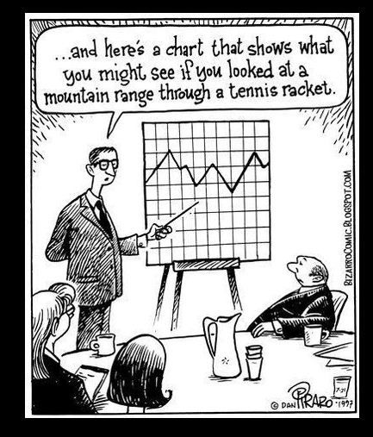
Measuring health status and quantifying health disparities for individuals with IDD, physical disabilities, and psychiatric conditions

Slide 32
Childhood and adolescent health disparities: Seizures
Indicator | NCI-IDD CFS 2022-2024 | NSCH 2022-23 (overall sample)
Epilepsy/Seizure disorder or other neurological condition | 15% | 1%

Slide 33
Childhood and adolescent health disparities: Diabetes
Indicator | NCI-IDD CFS 2022-2024 | NSCH 2022-23 (overall sample)
Epilepsy/Seizure disorder or other neurological condition | 15% | 1%
Diabetes | 3% | 0.1%

Slide 34
Childhood and adolescent health disparities: Heart conditions and cardiovascular disease
Indicator | NCI-IDD CFS 2022-2024 | NSCH 2022-23 (overall sample)
Epilepsy/Seizure disorder or other neurological condition | 15% | 1%
Diabetes | 3% | 0.1%
Heart condition/cardiovascular disease | 10% | 3%

Slide 35
Childhood and adolescent health disparities: Mental health issues and treatment
Indicator | NCI-IDD CFS 2022-2024 | NSCH 2022-23 (overall sample)
Epilepsy/Seizure disorder or other neurological condition | 15% | 1%
Diabetes | 3% | 0.1%
Heart condition/cardiovascular disease | 10% | 3%
Anxiety or mood disorder | 15% | Anxiety: 12% Mood: 6%
Difficulty getting mental health treatment | 40% | 44%

Slide 36
Adult health disparities: Diabetes
Rates of diabetes are 2.8X-5.6X higher among those with disabilities than in the general population
Intellectual/Developmental disability (NCI-IDD)
*Data from BRFSS respondents is self-reported. All NCI-IDD data comes from administrative records. NCI-AD data on diabetes is about 70% self-reported, and 30% from administrative data.

Slide 37
Adult health disparities: High blood pressure
Rates of high blood pressure are approx. 2x higher among those with disabilities than in the general population
Intellectual/Developmental disability (NCI-IDD)
*Data from BRFSS respondents is self-reported. All NCI-IDD data comes from administrative records. NCI-AD data on high blood pressure is 69% self-reported, and 31% from administrative data.

Slide 38
Adult health disparities: Heart disease
Rates of heart disease are 2.5X-10X higher among those with disabilities than in the general population
Intellectual/Developmental disability (NCI-IDD)
*Data from BRFSS respondents is self-reported. All NCI-IDD data comes from administrative records. NCI-AD data on heart disease is 68% self-reported, and 32% from administrative data.

Slide 39
Adult health disparities: Fair or poor self-reported health
Rates of fair or poor self-reported health are 1.5X-6.5X higher among those with disabilities than in the general population
Intellectual/Developmental disability (NCI-IDD)
Data from general population comes from BRFSS. All data shown is self-reported or proxy-reported.

Slide 40

Adult health disparities: Overweight or obesity?
Indicator | NCI-IDD IPS | BRFSS *
Overweight or obese | 65% | 67%
*Data from BRFSS respondents is self-reported. All NCI data comes from administrative records.

Slide 41
Differences in healthcare use
Indicator | NCI-IDD IPS | NCI-AD ACS Physical Disability | NCI-AD ACS Psychiatric Disorder | BRFSS *
Routine health check in past year | 86% | 85% | 82% | 82%
Dental visit in past year | 77% | 48% | 55% | 44%
Mammogram in past 2 years for women between 40-75 | 72% |  |  | 79%
Pap test in past 3 years for women 21+ | 49% |  |  | 84%
*Data from BRFSS respondents is self-reported. All NCI-IDD data comes from administrative records. NCI-AD data is self-reported.

Slide 42

Disparities: how do they change as we age?
As we age, we all tend to have more health issues.
There’s lots of research looking at aging and health outcomes. But, we don’t really know if disparities in health change over time.
There’s some data on people as they age, but disability definitions in those data can vary a lot.

Slide 43
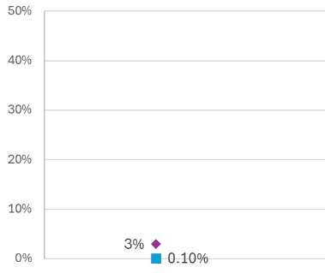
Stratifying cross-sectional data by age groups to examine diabetes disparities
DISCLAIMER: Data shown come from the NCI-IDD CFS (2022-2024) and the NSCH (2022). For the NSCH, data measure type 2 diabetes only, and all respondents as samples were too small to support stratification by disability type.
Less than 18 years old

Slide 44
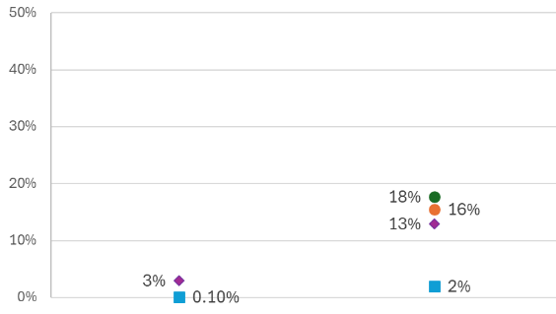
Stratifying cross-sectional data by age groups to examine diabetes disparities
DISCLAIMER: Data from 18–44-year-olds come from 3 different cross-sectional data sources: NCI-IDD IPS (2022-2024), NCI-AD ACS (2022-2024), and BRFSS (2022). Data from NCI comes from administrative sources or can be self-reported for NCI-AD, while BRFSS data is self-reported.
Less than 18 years old
18-44 years old

Slide 45
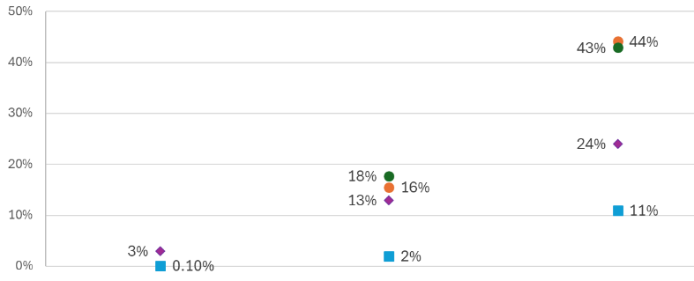
Stratifying cross-sectional data by age groups to examine diabetes disparities
DISCLAIMER: Data from 45-64-year-olds come from 3 different cross-sectional data sources: NCI-IDD IPS (2022-2024), NCI-AD ACS (2022-2024), and BRFSS (2022). Data from NCI comes from administrative sources or can be self-reported for NCI-AD, while BRFSS data is self-reported.
Less than 18 years old
18-44 years old
45-64 years old

Slide 46
Stratifying cross-sectional data by age groups to examine diabetes disparities
Less than 18 years old
18-44 years old
45-64 years old
65+ years old
DISCLAIMER: Data in this chart come from 5 different cross-sectional data sources. This chart gives us a direction to explore further areas of study, but does not provide any empirical evidence of longitudinal disparities.

Slide 47
Within survey analysis of health differences: the dual eligible population
Medicare is typically for people age 65 and older, but people with disabilities who are under 65 can sometimes qualify for both Medicare and Medicaid. This usually happens when someone has greater need for supports.
When someone qualifies for both Medicare and Medicaid services, they have “dual eligibility.” This can help cover more healthcare costs and services.
We wanted to know: What does NCI data tell us about dual-eligibles and how is this different by population?

Slide 48
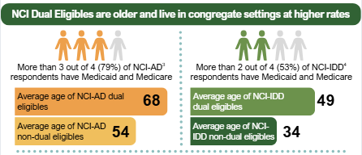
Key differences between those who are dual eligibles and peers who are not dually enrolled
79% of NCI-AD respondents are dual eligible
  On average, 14 years older than peers who are not dual eligible
53% of NCI-IDD respondents are dual eligible
  On average, 15 years older than peers who are not dual eligible

Slide 49
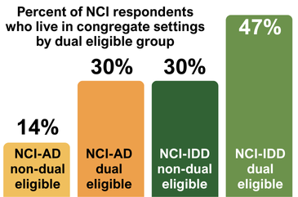
Key differences between those who are dual eligibles and peers who are not dually enrolled
79% of NCI-AD respondents are dual eligible
  2x higher rates of living in congregate settings than peers who are not dual eligible
53% of NCI-IDD respondents are dual eligible
  1.5x higher rates of living in congregate settings than peers who are not dual eligible

Slide 50
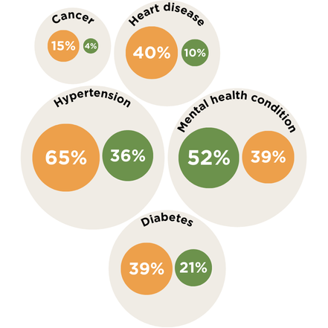
Even after accounting for older age, dual eligibles have high rates of chronic conditions
Dual eligibles have significantly higher rates of many chronic conditions than peers with IDD who are not dual eligible
We also see that duals are significantly more likely to use preventive healthcare than non-dual peers, but still have significantly higher rates of acute care

Slide 51

When it comes to measuring disparities, we need to be SPECIFIC
It can really hinder our understanding to lump all people with disabilities into one group.
We need to look at people with different types of disabilities and at different phases of life to better understand what their needs are.

Slide 52

Implications and Future Directions

Slide 53

Disparities are hard to measure well
Survey measures of disability measure functional status. In other words, whether someone has difficulty doing certain tasks.
This makes it harder to look at:
Differences within each disability subgroup
Differences between different disability subgroups
Data doesn’t always include people with more significant support needs. So, we don’t know much about how their health differs from peers with and without disabilities.

Slide 54
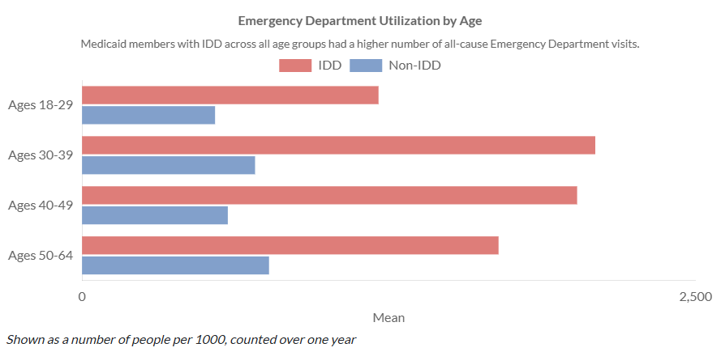
Getting to stronger comparisons with matched cohorts
The UCEDD at OHSU worked with state Medicaid claims data in 2022. They wanted to look at differences in key health domains.
They included 2,066 Oregonians with IDD who use Medicaid and 2,066 Oregonians without IDD who use Medicaid.

Slide 55

Do we have a case for unequal health?
These data represent possible signs of unequal health, BUT because the datasets are different, results cannot be viewed as conclusive evidence.

Slide 56
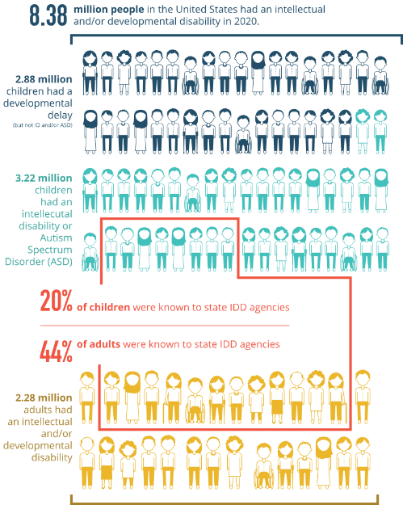
Limitations: NCI data doesn’t include everyone
NCI respondents are an estimated 44% of people with IDD (those who are known to state agencies)
NCI respondents may have greater support needs than peers who are not receiving state-funded services

Slide 57

Limitations: terminology and communication
Sometimes, research unintentionally uses ableist language
  E.g. “medically complex”
Other times, research uses too strong or too narrow language
  E.g., “this impacts outcomes” suggest causality, when in fact it’s just a strong association
When we don’t communicate these nuances well, we can lose trust of partners and audiences
  E.g., COVID-19 messaging

Slide 58

Teamwork makes the dream work!
We know that knowledge is power. And there’s lots of good data out there, but it is not always used responsibly and accurately. Other times, we don’t have the data we need.
How can we leverage this data (and other data) with our partners to improve health for people with disabilities?

Slide 59
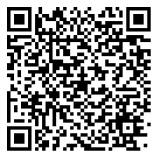
Stay connected for updates!
NCI updates newsletter
NCI Facebook page:
www.facebook.com/nationalcoreindicators
NCI website:
www.nationalcoreindicators.org

